Slide 1
Family conflicts
the 9th form

Slide 3
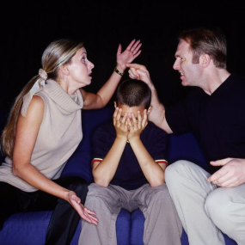
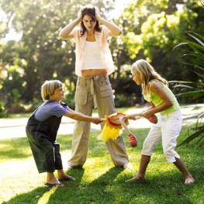
WHAT IS CONFLICT?
.
THE FAMILY CONFLICTS

Slide 4
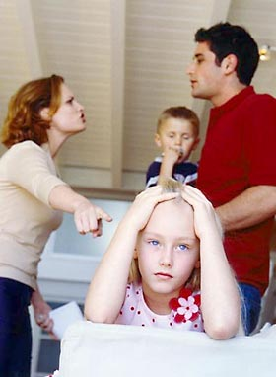
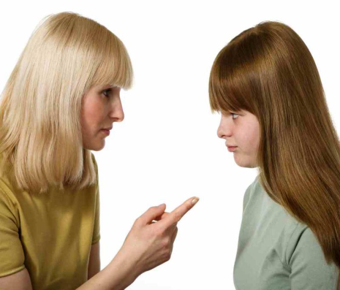

Slide 5
Make up sentences
using the words
people suffer
hear what
neither listen
sometimes
parties or states
During
to each other
different with
lead to war,
should
relations, fights
and kids
Conflicts
peacefully
may lead
and values
and even
Both
people are
conflicts
Conflict
thing in
life
natural
is a
people’s
Conflict
.
Conflicts between
which make
.
we’re saying
happen as
their ideas
.
.
resolve
conflicts we
grown-ups
nor really
violence
to bad
.
.

Slide 6
The questions of the lesson:
Why do conflicts happen?
What or who can be involved in any conflict?
What can different conflicts lead to?
Is it necessary to prevent conflicts? How? Why?

Slide 7
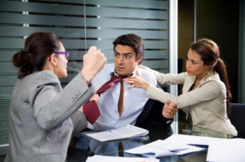
What can different conflicts lead to?

Slide 8
How to avoid(prevent) the conflicts ?
People should
People shouldn`t
People shouldn’t
listen to each other
calm down and talk very calm
find any compromise
give some pieces of advice
respect the opponent’s opinion
work out a list of rules
try to forgive
understand the younger (older) generation
rely on own family…
spoil the mood
threaten or frighten (bully)
make fun of smb
make smb feel uncomfortable
make smb suffer from…
envy smb’s success
betray friends
criticize smb\
shout and quarrel
irritate smb…

Slide 9
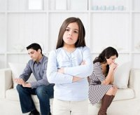
“PLANT KINDNESS AND LOVE WILL GROW”

Slide 10
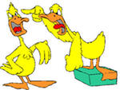
Role-playing

Slide 11
Thank you for the lesson

