Slide 1
Cookery competition

Slide 2
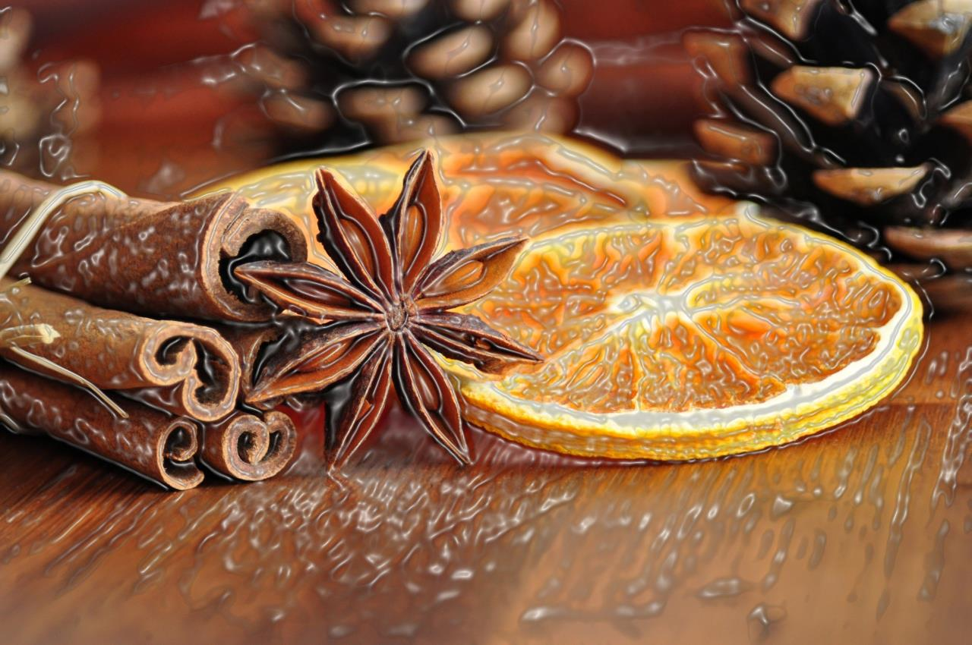
Warming - up
You should name food one by one till another team cant continue…

Slide 3
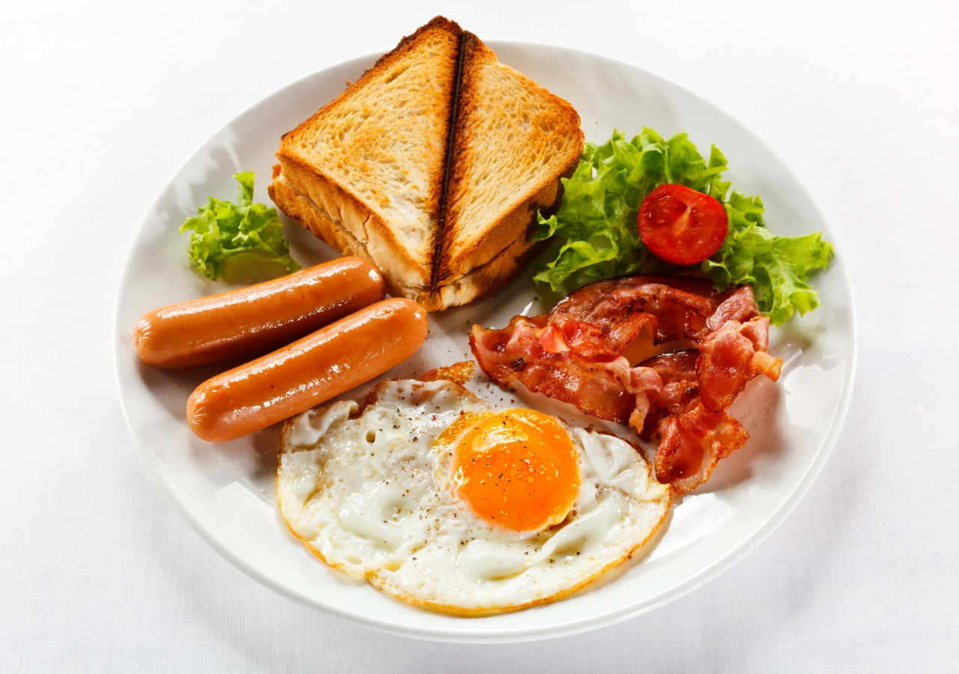
Complete….
DRINKS- tea,….
VEGETABLES- tomatoes,…
FRUITS-apples,…
COLD FOOD-cheese,….
HOT FOOD- soup,….
SWEET THINGS- chocolate….

Slide 4
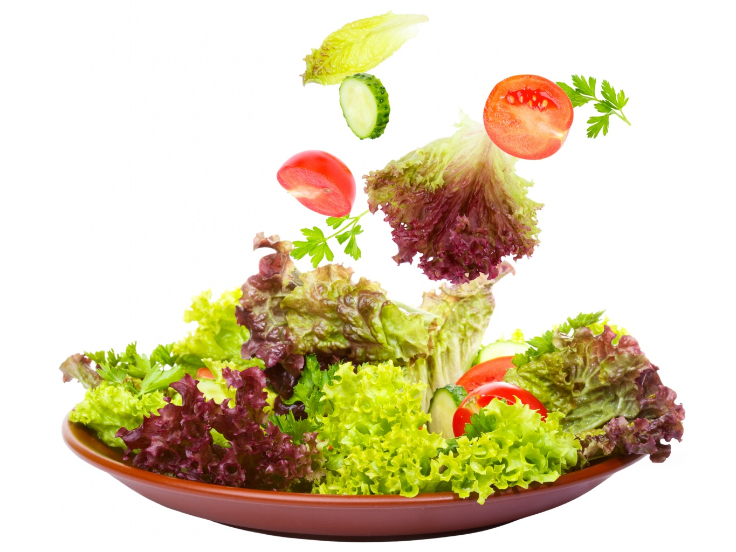
ODD ONE OUT…
Bacon, beef, turkey, pork, lamb
Carrot, melon, onion, cabbage, cucumber
Lemonade, tea, sugar, coffee, mineral water, juice
Grapes, apple, pear, plum, ice- cream
Butter, milk, cheese, oil, youghurt
Cake, sweet, chocolate, jam

Slide 5
Look at the pictures…..

Slide 6
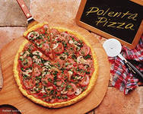
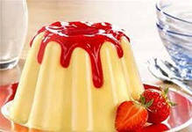
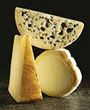
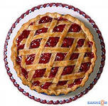
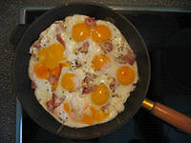
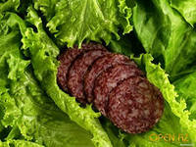
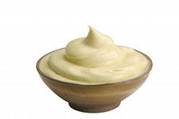
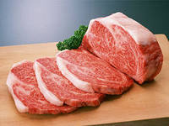
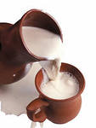
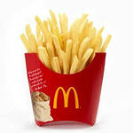
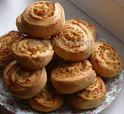
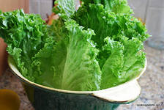
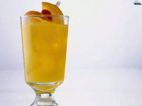

Slide 7
And now, name the missing ones!

Slide 11
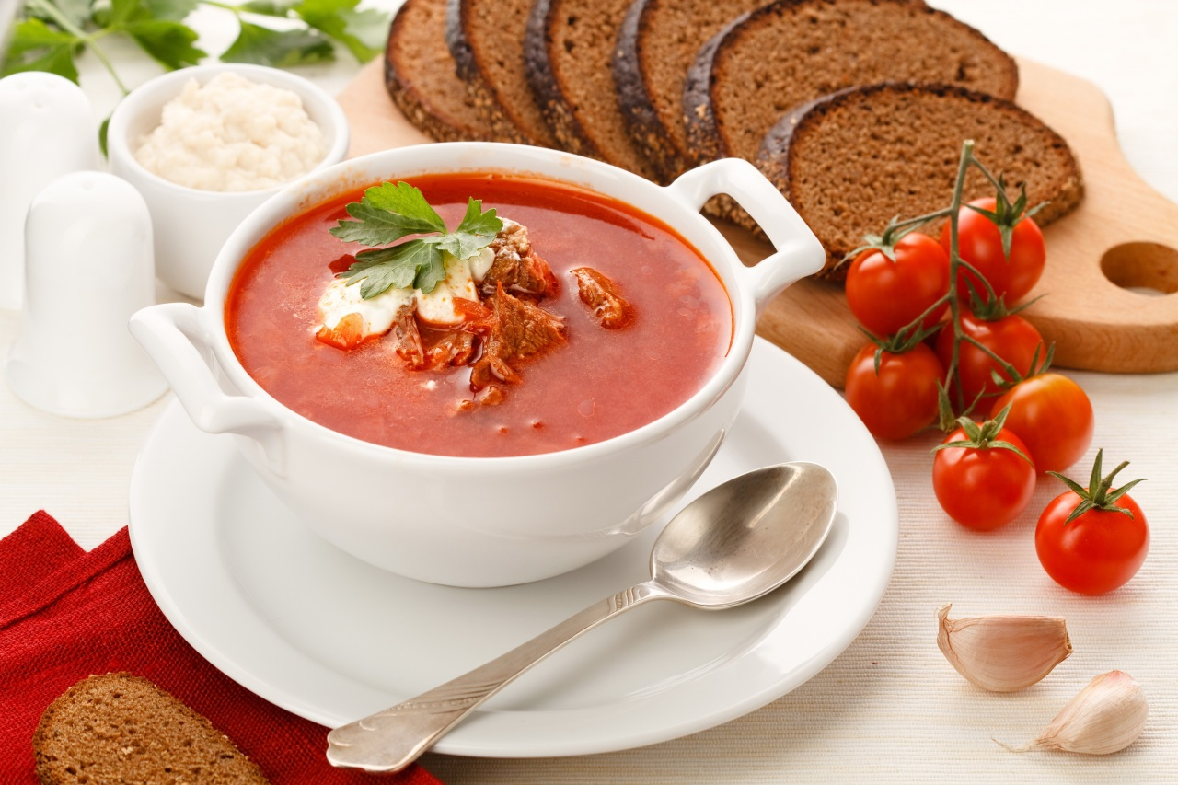
Cross-word….

Slide 12
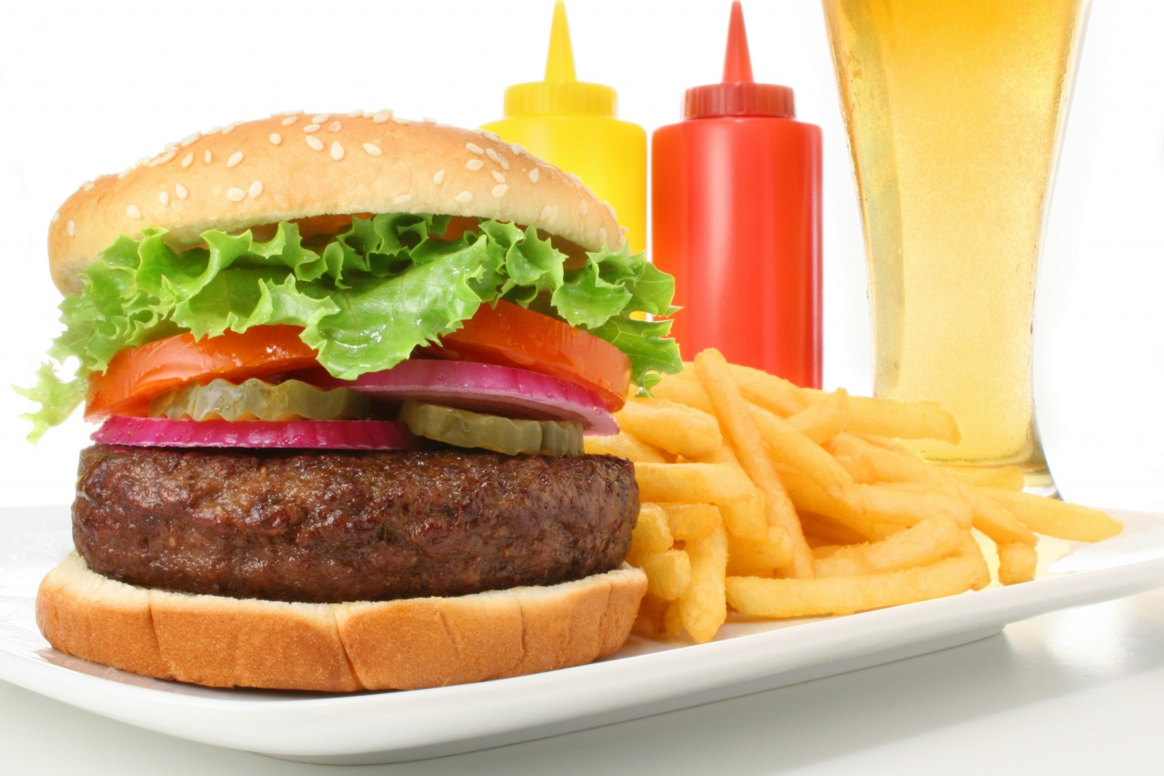
MAKING SANDWICHES…..

Slide 13
And now, we are going to prepare the sandwiches. Let`s read the recipe and follow it!

Slide 14
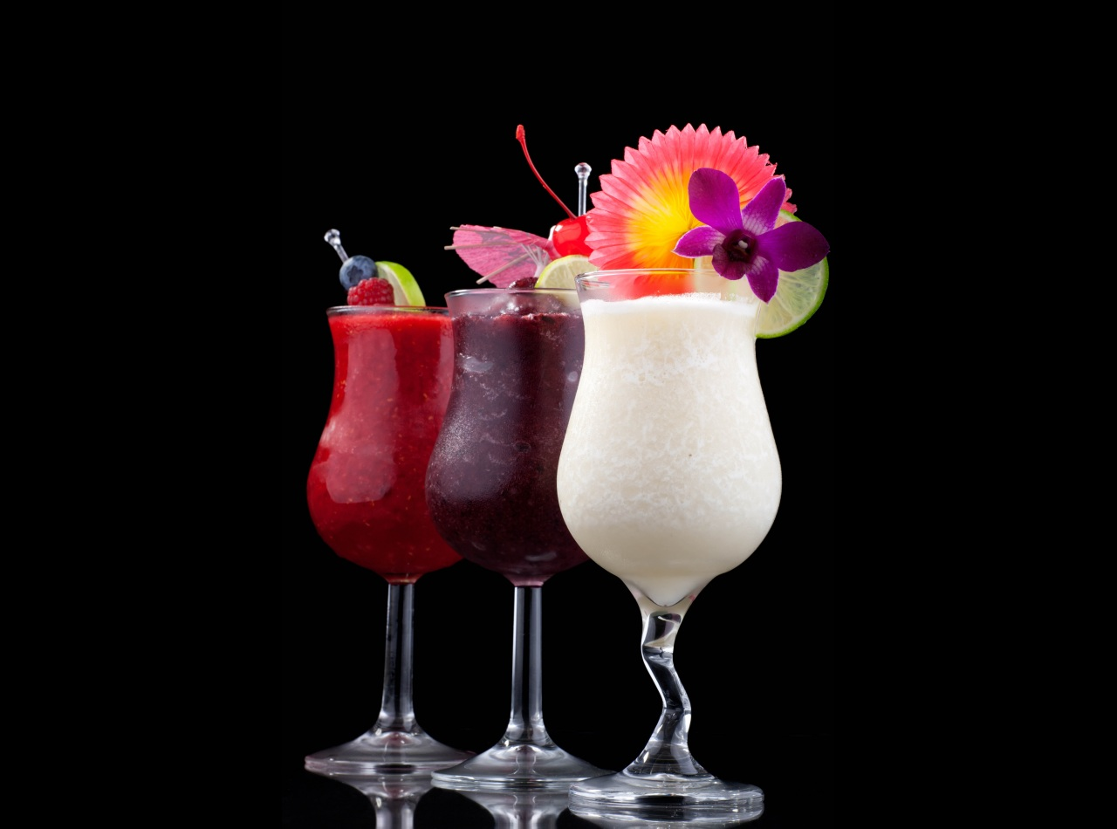
1.Put some lettuce on the first slice of bread.
2.Cut the cheese into slices.
3.First put some butter on the bread
4.And now it`s ready-the Top Show sandwich!!
5. You need bread, butter ,lettuce , tomato, cheese and prawns.
6.Put the prawns on the chees.
7.Then put the second slice of bread on the lettuce and tomato.
8.Put the cheese on the bread.
9. Put the tomato on the lettuce.
10 Finally , put the third slice of bread on the top.

Slide 15
Russian meal vs British meal

Slide 16
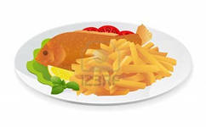
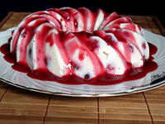
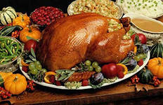
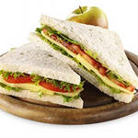
Traditional British food
Pudding
Fish and chips
Turkey
Tea
Sandwich

Slide 17
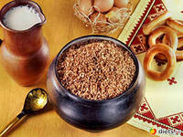
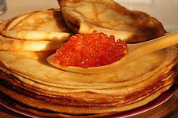
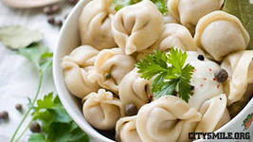
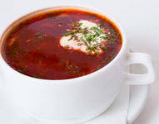
Traditional Russian food
buckwheat porridge
Pancakes
Meat dumplings
Kvass (rye beer)
Borsch

Slide 18
So, what food do you prefer?

