Slide 1
Environment problems

Slide 2
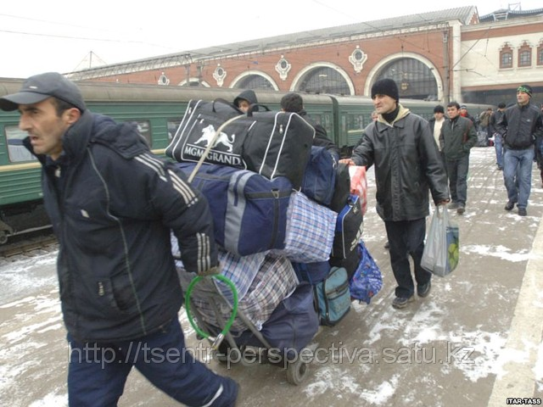
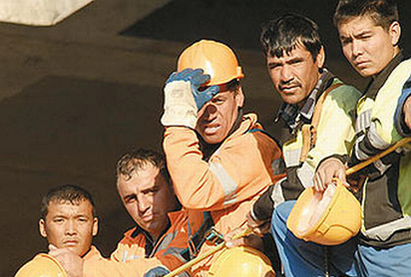
Environment problems in Russia At present Russia in my opinion the dirtiest country in the world. 1)Because it is the biggest country and on it live a set of nationalities and it plays large role harming the nature. The most large number of migrants is the share of Russia!

Slide 3
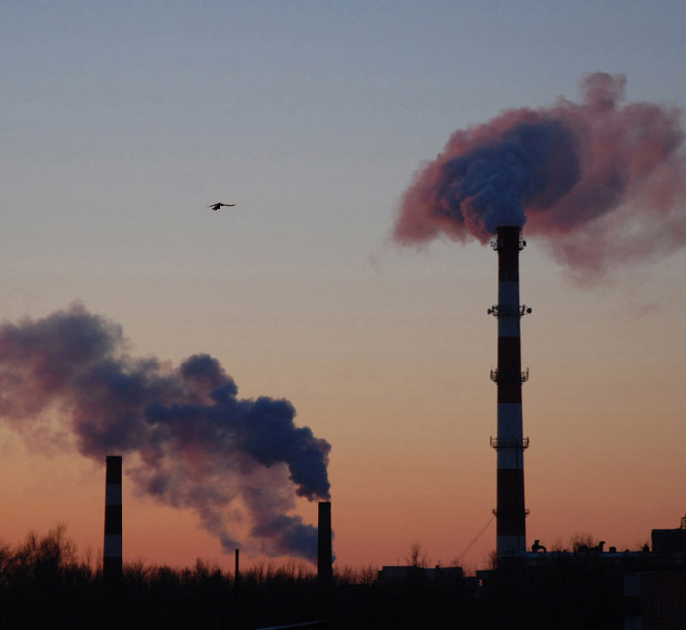
2) Secondly to earn and develop economy, the big enterprises which unfortunately harm not only environment, but also people are necessary, polluting air.

Slide 4
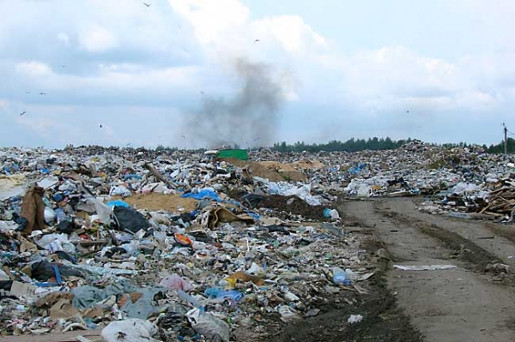
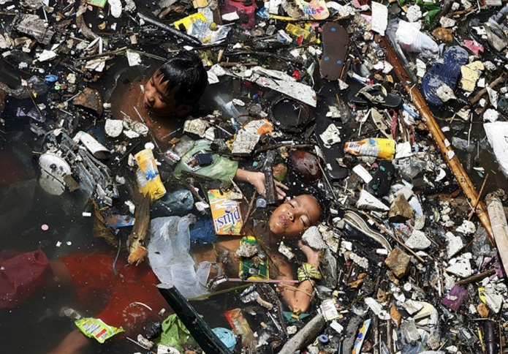
3) Thirdly people behave disrespectfully on the relation to everything that the nature gives us, throw out garbage there where there are no garbage containers. Cut down the woods. Gradually pollute lakes and the rivers therefore suffers not only level of purity of water in the lake, but also all sea inhabitants, and ourselves suffer from it also.

Slide 5
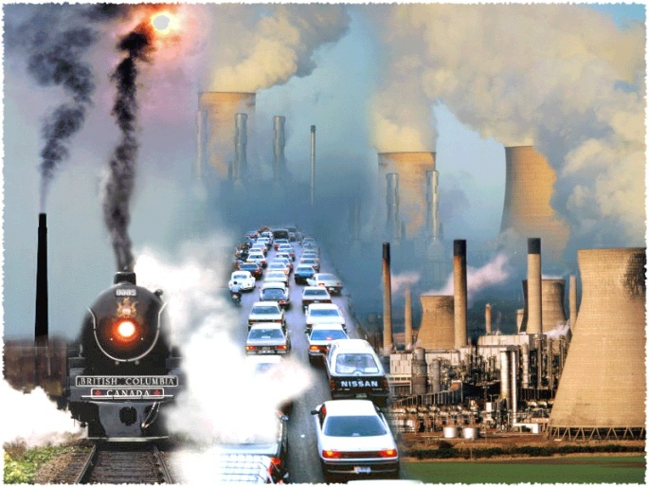
All these factors influence not only separately Russia, but also all planet. Without meaning what exactly your small piece of paper will be pernicious, we continue negligently treats the nature!

Slide 6
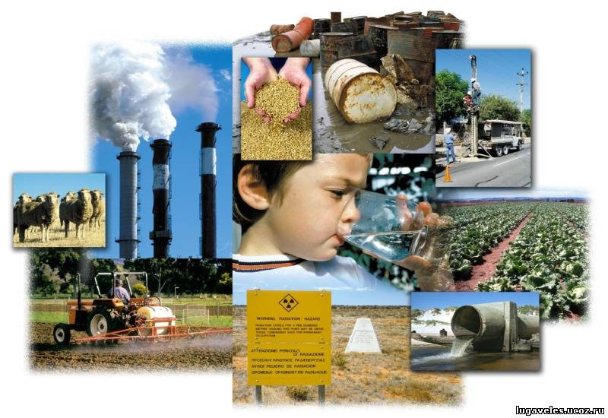
Between it there is a difference

Slide 7
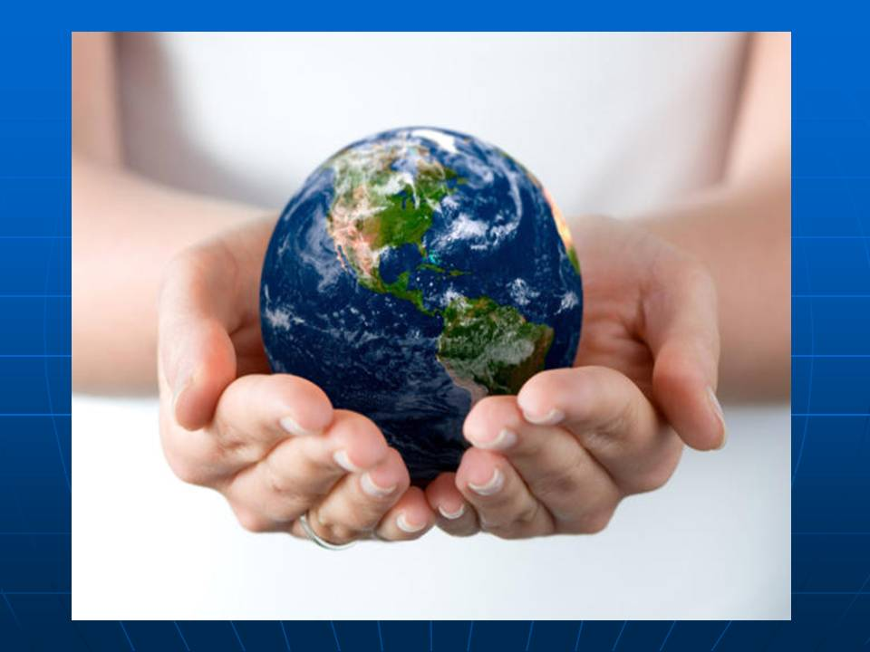
Let's keep the nature together. After all if we continue to pollute environment, sooner or later it is necessary to pay for the acts!

Slide 8

It costs that!

Slide 9
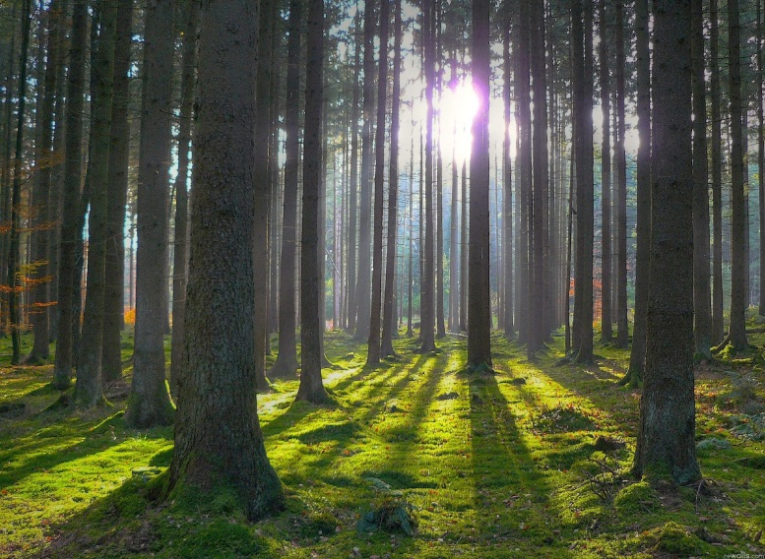
All these factors influence not only separately Russia, but also all planet. Without meaning what exactly your small piece of paper will be pernicious, we continue negligently treats the nature

Slide 10
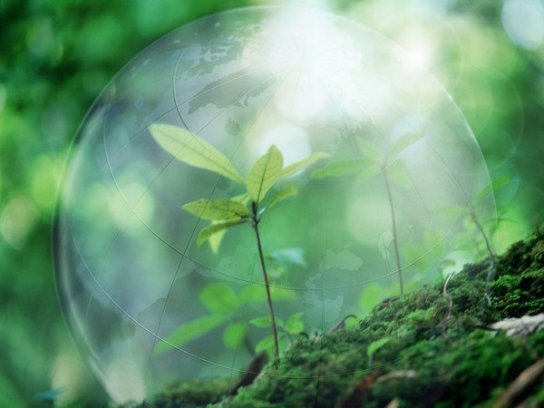
Remember, polluting the nature you first of all harm to itself! So reflect while the getting is good!

