Slide 1
ENVIRONMENTAL PROTECTION:
New Zealand

Slide 2
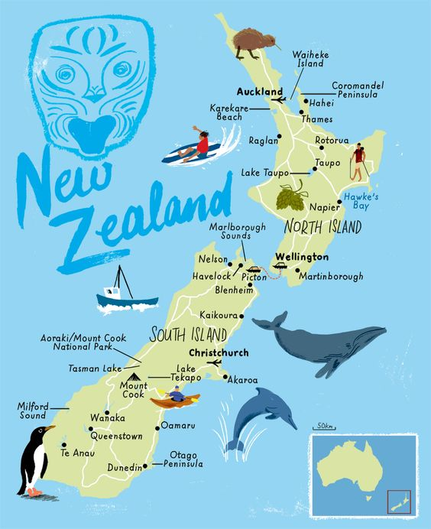
New Zealand is known for its unique biodiversity, caused by its remarkable geography and geologic history. Breaking away from the supercontinent Gondwana about 80 million years ago, it has developed a distinct flora and fauna as a result of long geological isolation. Thus, many fascinating plants and animals are found nowhere else but in New Zealand. The number of endemic species (species that are not found anywhere else) is one of the highest in the world, making New Zealand an excellent case study to teach and learn about the fundamentals of Biology.

Slide 3
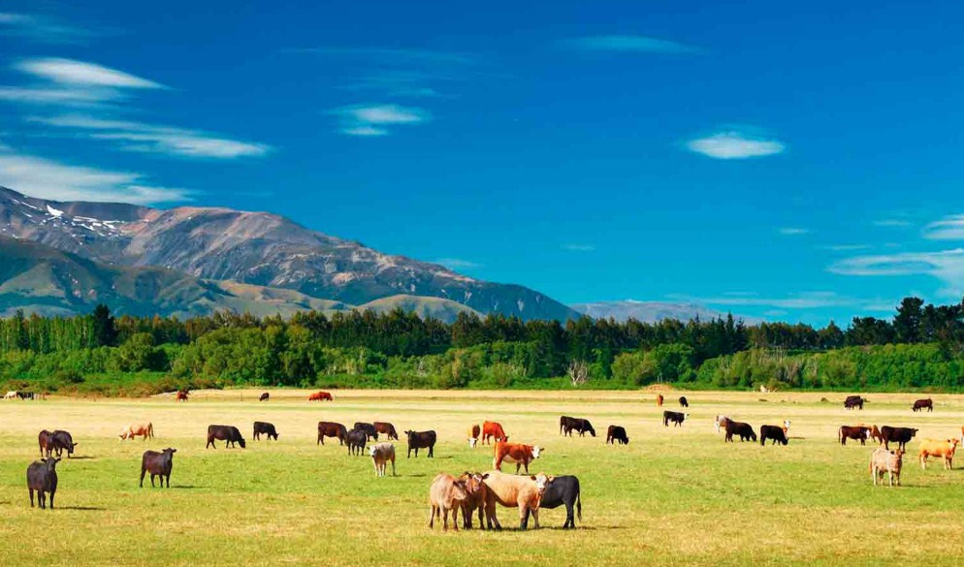
New Zealand's environmental problems
With much of its economy based on agriculture, New Zealand must cope with the damage that agriculture takes on in its natural environment. Both Maori and British settlers were responsible for deforestation or drainage of large tracts of land.Intensive dairy production has increased nitrogen levels in surface, groundwater and soil waters. One of the biggest environmental problems here is soil degradation. The loss of trees has made much of the countryside insufficiently protected from heavy rainfall, which quickly wipes out the fertile soil. New Zealanders are also particularly concerned about the state of the soil: excess acidification, loss of vital organic substances and a decrease in the number of earthworms and other soil-friendly organisms.While it faces air pollution, mainly from cars, half of New Zealand's greenhouse gas emissions come from agriculture. The agricultural sector also leads to significant runoff of fertilizers and pesticides, which can enter streams and rivers. Critics say that the country also lacks water distribution and use strategies, and water does not always go to where it creates the most value. Freshwater pollution and scarcity thus exacerbate the problems.

Slide 4

New Zealand's Environmental policy
Based on the Resource Management Act, the New Zealand Government has stated its desire to follow the principles of sustainable development in its economic, social and environmental policies.In 2009, the law was revised to simplify regulations and reduce costly delays for developers and investors while supporting the necessary environmental protections, resulting in faster processing and better compliance.Despite New Zealand's relatively small share of total global emissions, the country has committed itself to working with other countries on climate change issues. The New Zealand Emissions Trading Scheme (ETS), adopted in 2008, is the main domestic policy to encourage emissions reduction. Biological emissions from agriculture are currently exempt from ETS.The New Zealand Government has also taken numerous steps to preserve the country's biological diversity. The New Zealand Biodiversity Strategy calls for increased education and engagement at the local level, strengthening partnerships with people regarding the conservation of genetic diversity, as well as the maintenance and improvement of natural habitats. ,

Slide 5
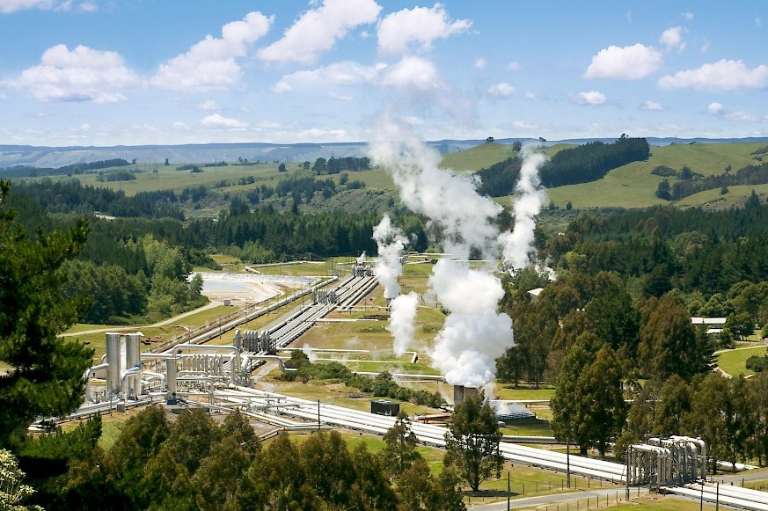
Clean technologies in New Zealand
New Zealand lags behind the rest of the world when it comes to clean technology. In a 2014 World Wildlife Fund report, New Zealand was named the intermediary country among 40 developed countries in the world when it comes to clean technologies.Without significant internal sources of funding, enterprising New Zealanders in many sectors have struggled to bring their innovations to market. The WWF report says that New Zealand has a good infrastructure when it comes to innovation, but is lacking when it comes to financial promotion of a start-up business.However, there are several success stories in the field of clean technologies. In New Zealand, about 80% of electricity is generated from renewable resources, and it provides clean electricity in abundance. Drive Technologies, based in Wellington, manufactures highly efficient electric motors. Meridian Energy was part of an initiative to install solar panels on dairy sheds across the country. New Zealand also has 30 different companies operating in the geothermal sector. The 2016 electric Vehicle program provides for doubling the fleet of electric vehicles every year until 2021. Recycling of paper, plastics, glass and metals is widespread in many parts of New Zealand. However, the country does not regulate the management of hazardous waste. The Waste Management and Minimization Plan (2012) in Auckland forces the polluter to pay for unsorted household waste, maximizing its recycling. This principle reduces waste sent to landfills.

Slide 6

A clean future?
As a relatively isolated and agriculture-based society, New Zealand does not have many factors pushing it to adopt clean policies and technologies, unlike China or other highly industrialized countries. In addition to New Zealand's role as a unique biodiversity hotspot, agriculture presents its own environmental challenges. Nevertheless, the country is becoming a world leader in the field of species restoration and pest control. The government aims to eliminate all possums, rats and stoats by 2050. This helps in the population status of local species.Although New Zealand had the highest share of the R&D budget for the environment in 2015, its revenues from environmental taxes in 2016 are among the lowest.Critics say the country does not seem particularly alarmed by the current state of its soil or water, leading to a lack of leadership on these issues. According to the New Zealand Environmental Foundation, a conservation and conservation consulting firm, restoration of waterways in New Zealand could take "hundreds of years" at the current rate of progress.However, New Zealand is socially and politically at the forefront of international climate issues, as evidenced by its adoption of a progressive carbon trading scheme. The country is also making it clear that it wants to boost its startup ecosystem, especially when it comes to clean technologies.
Environmental and climate technologies are improving. New Zealand is a world leader in research on reducing the environmental impact of agriculture. It has a well-developed and qualified eco-innovation system.A 2014 WWF report stated that New Zealand is ripe for a clean technology revolution, and noted that countries that invest "significant resources in supporting clean technology innovation are rewarded by new and commercialized clean technology companies."In 2016, the government took measures aimed at "green New Zealand's economy and improving environmental governance and governance, with a particular focus on water management and sustainable urban development." New Zealand is committed to reducing greenhouse gas emissions by 30% below 2005 levels by 2030. The 2017 OECD Environmental Performance Reviews state that New Zealand is among the most energy-intensive countries.It is necessary to maintain New Zealand's reputation as a "green" country, both as a tourist destination and as a producer of natural and safe food products.

Slide 7

THANK YOU FOR YOUR ATTENTION!

