Slide 1


Slide 2
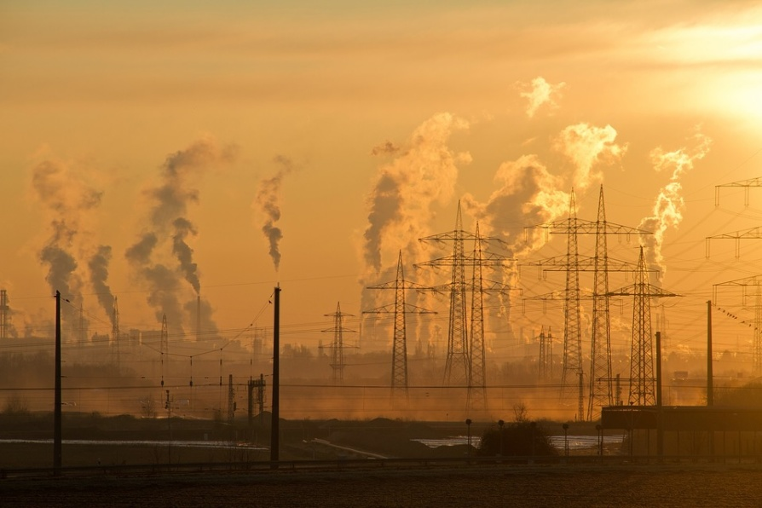
1. air pollution this is a pretty popular problem in the world. in a large community is in big cities. оld people and children suffer from it

Slide 3
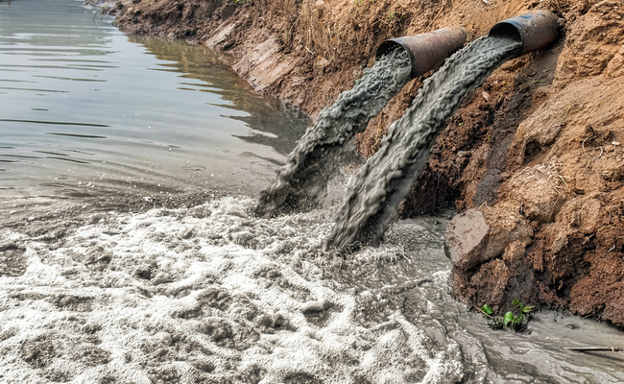
2. water pollution these days water is used as a dump. Waste from factories and industries goes there, animals and soil near water suffer from this

Slide 4
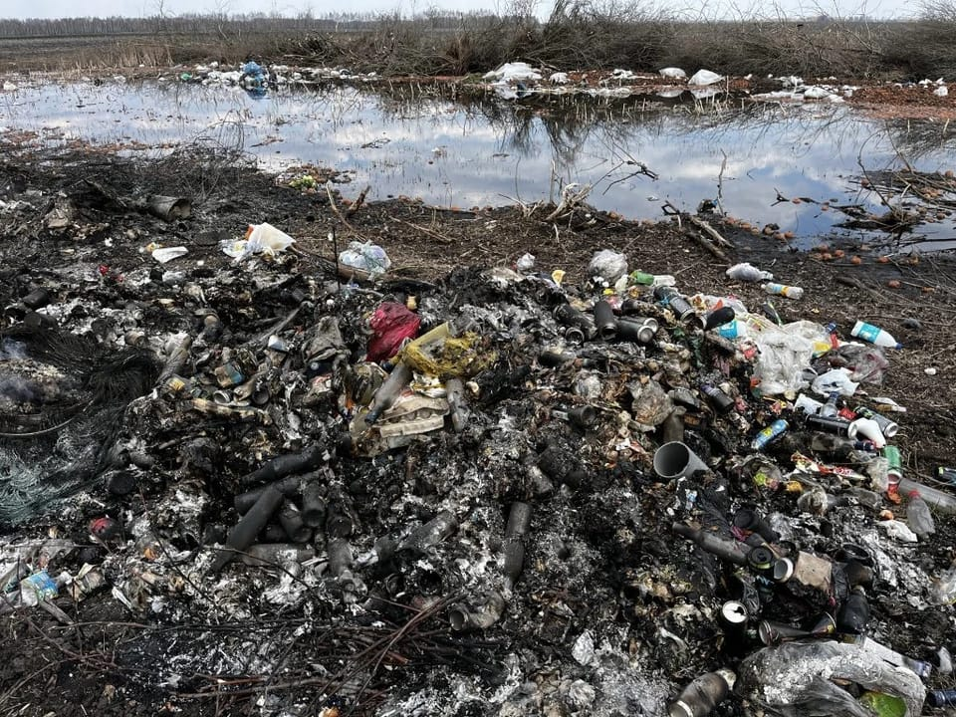
3. soil pollution
is a very important problem. It affects both animals and plants, and the products we eat. People often litter where it is not necessary, and this leads to this.

Slide 5
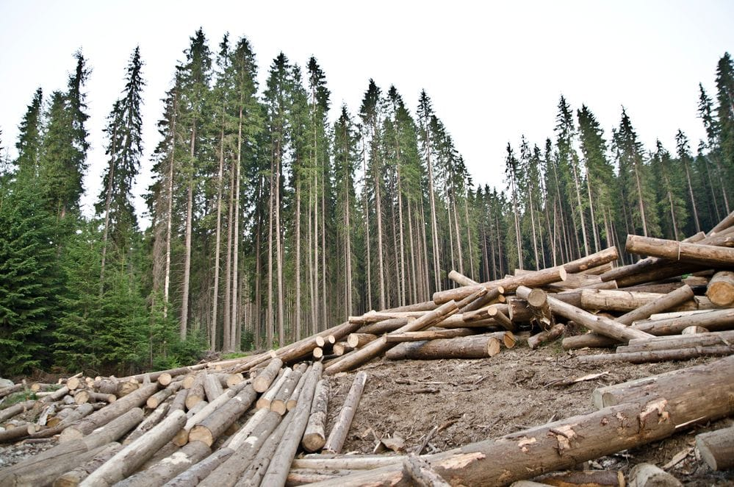
4. Deforestation
people cut down forests to build some building or something else on the site. animals and air suffer from this. other birds have nowhere to live

Slide 6
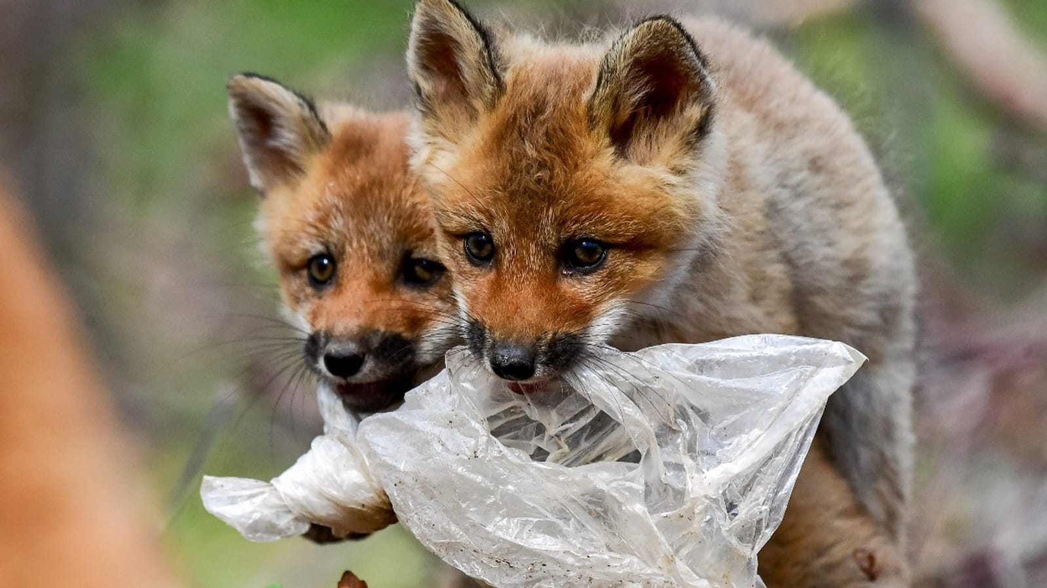
5 animals are in danger
of all the problems said for you, there is one more. animals are in danger because of this. because of what people do, they often have to survive in bad conditions

Slide 7
Conclusion don't pollute the world!!! don't ruin your own lives!!!

Slide 8


