Slide 1
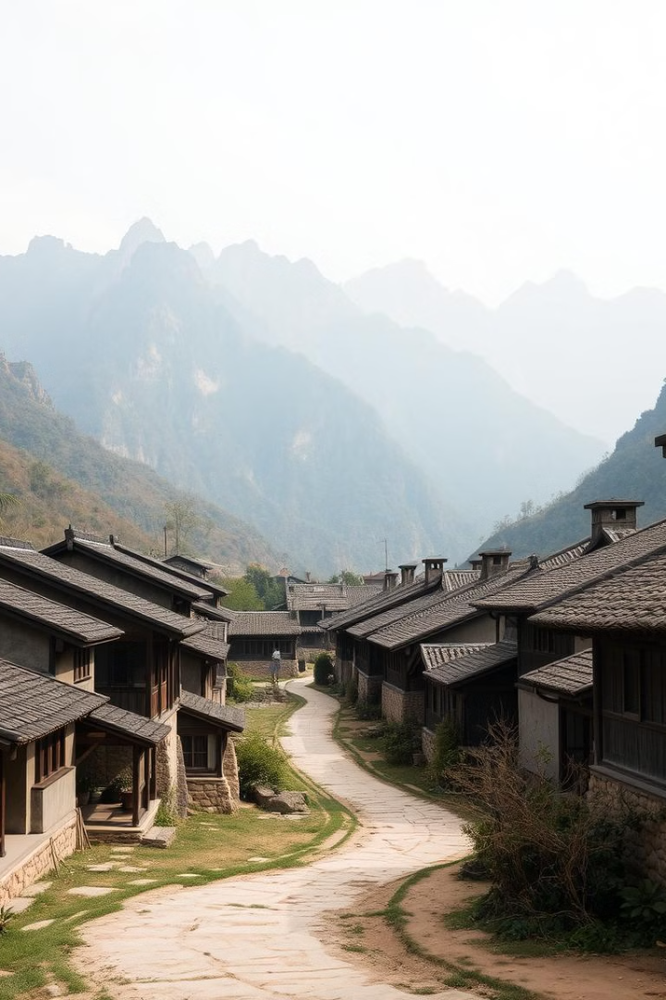
Ancient China
Explore the history, culture, and achievements of Ancient China.

Slide 2
Geography and Climate
Diverse Landscape
Varied Climate
Ancient China had a vast and diverse landscape, with mountains, deserts, and fertile plains.
The climate varied widely, with hot, humid summers and cold, dry winters.

Slide 3
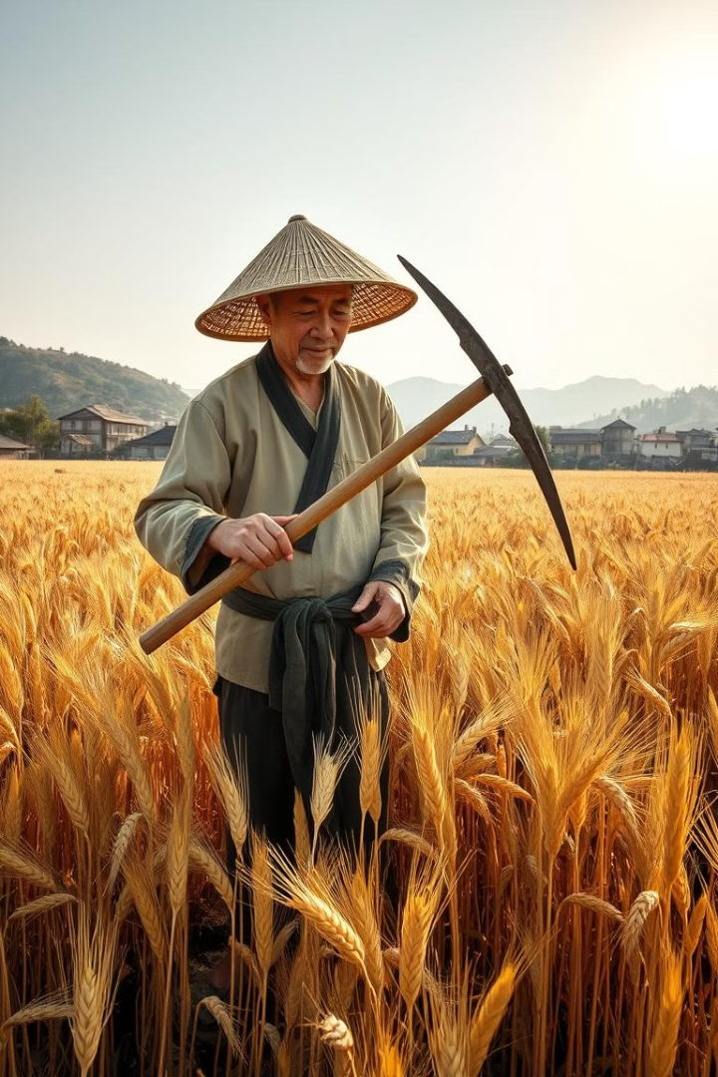
Agriculture and Crafts
Farming
Rice was the main crop, but farmers also grew wheat, barley, and millet.
Crafts
Craftsmen produced silk, pottery, and bronze objects.

Slide 4
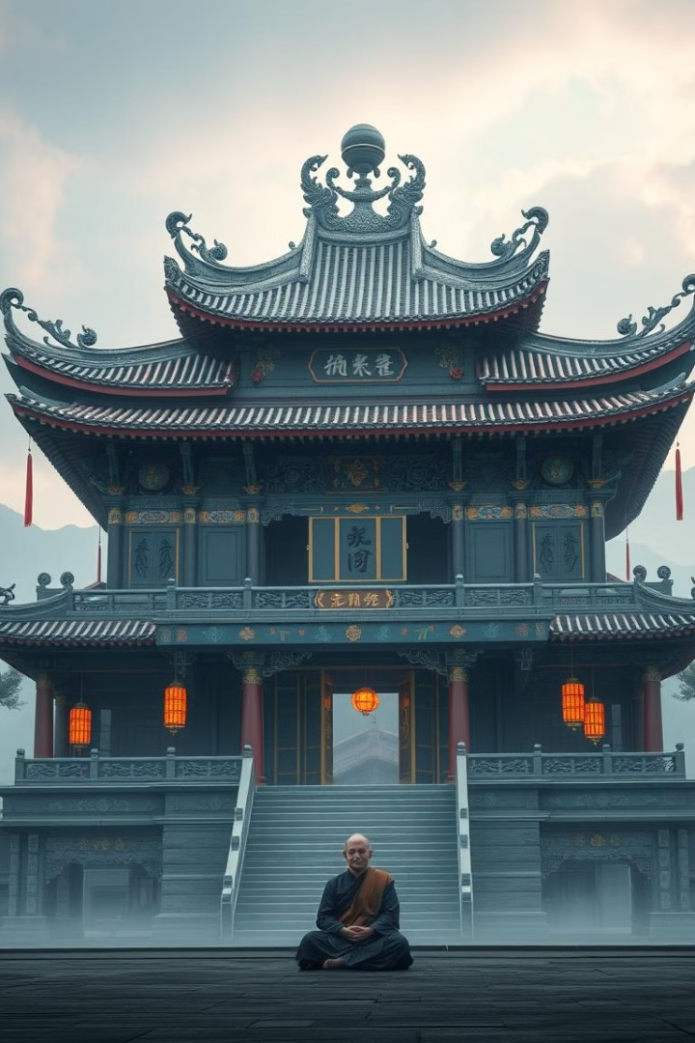
Religion and Philosophy
Confucianism
Daoism
Confucianism emphasized social harmony, respect for elders, and good governance.
Daoism focused on living in harmony with nature and the Dao (the way).
Buddhism
Buddhism spread from India and gained popularity in China.

Slide 5





Inventions and Technology
Compass
Paper
Gunpowder
Printing Press
The compass was used for navigation.
Paper revolutionized communication and knowledge sharing.
Gunpowder was used for fireworks and later weapons.
The printing press made books more accessible.

