Slide 1
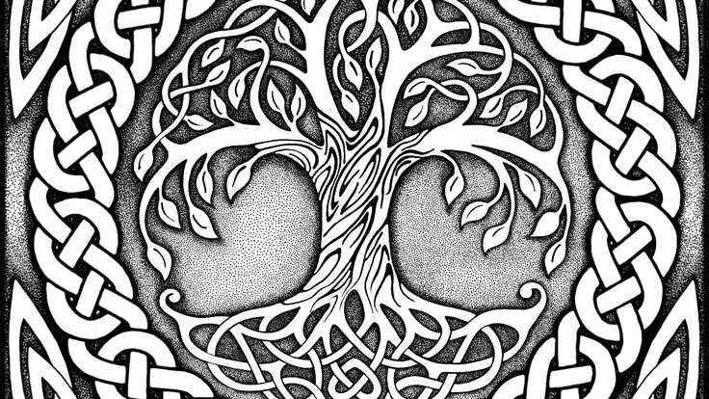
Celtic art

Slide 2
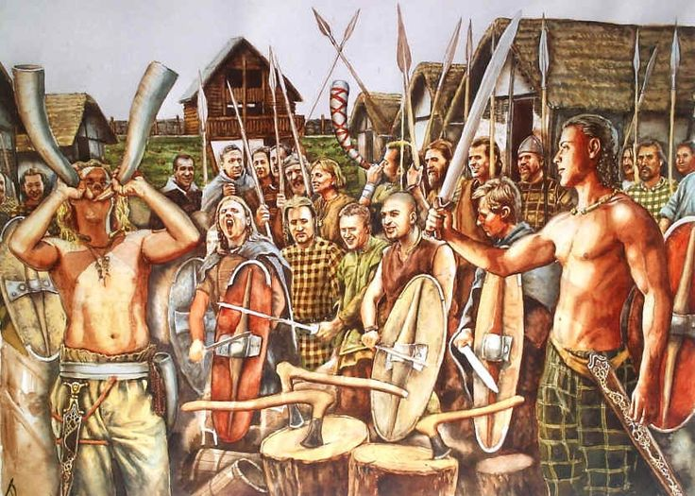
Celtic art is associated with the peoples known as Celts; those who spoke the Celtic languages in Europe from pre-history through to the modern period, as well as the art of ancient peoples whose language is uncertain, but have cultural and stylistic similarities with speakers of Celtic languages.

Slide 3
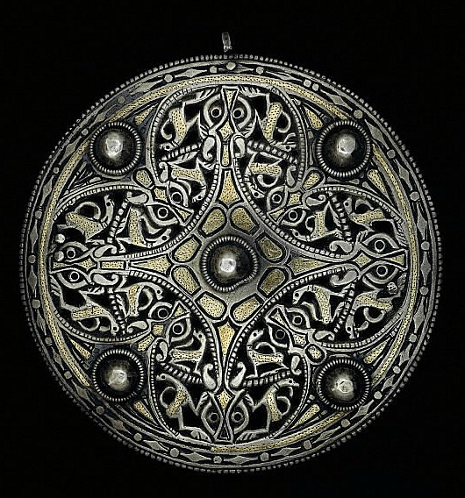
Typically, Celtic art is ornamental, avoiding straight lines and only occasionally using symmetry, without the imitation of nature central to the classical tradition, often involving complex symbolism.

Slide 4
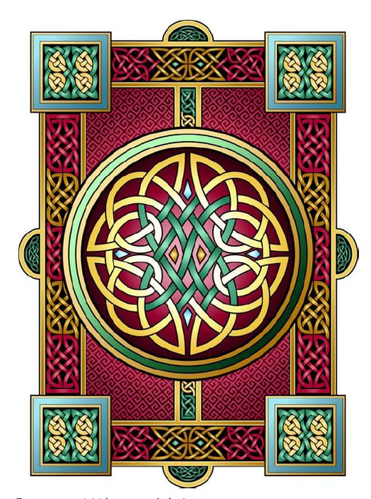
In the 7th and 9th centuries Irish Celtic missionaries travelled to Northumbria in Britain and brought with them the Irish tradition of manuscript illumination, which came into contact with Anglo-Saxon metalworking knowledge and motifs.

Slide 5
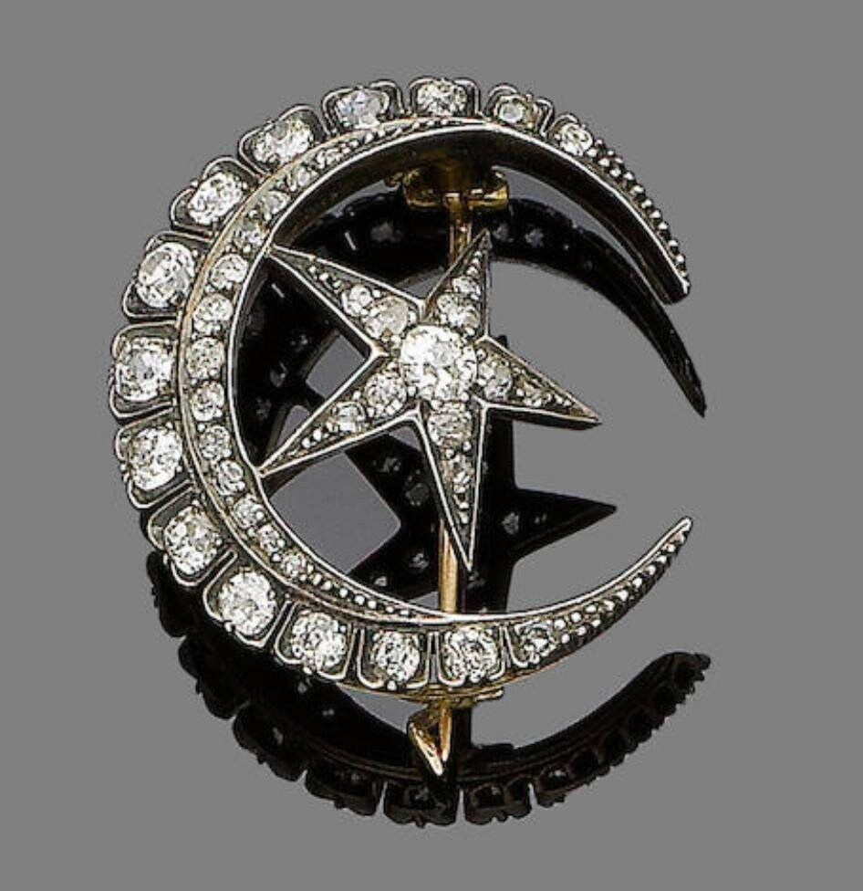
In the 9th and 11th century plain silver became a popular medium in Anglo-Saxon England, probably because of the increased amount in circulation due to Viking trading and raiding, and it was during this time a number of magnificent silver penannular brooches were created in Ireland.

Slide 6
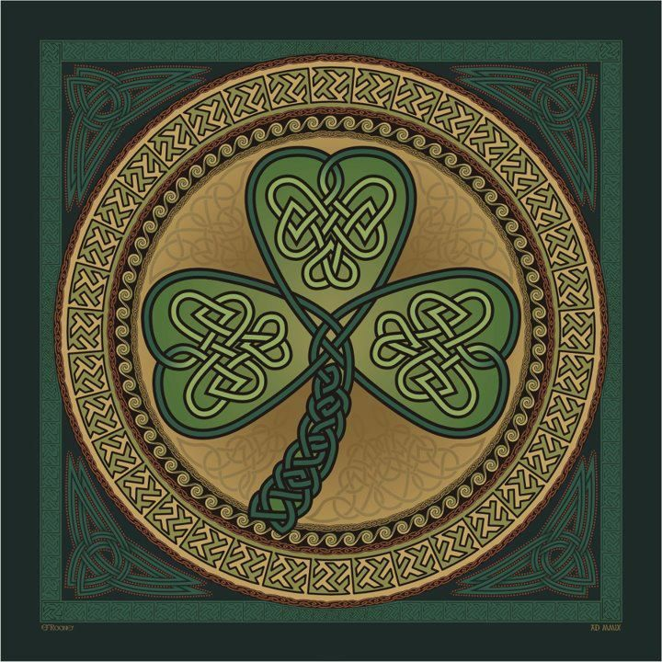
By the 1980s a new Celtic Revival had begun, which continues to this day. By the 1990s the number of new artists, craftsmen, designers and retailers specializing in Celtic jewelry and crafts was rapidly increasing. The Celtic Renaissance has been an international phenomenon

