Slide 1
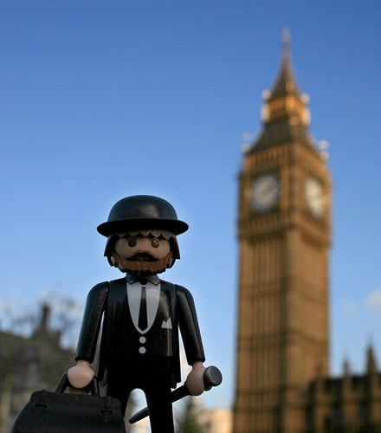
British Character
Lyudmila Kovtun
School № 44
Khabarovsk

Slide 2
We are going to study:
the most characteristic features of the British mentality
the British character
British manners and etiquette
Useful tips for travelers

Slide 3
Mentality
Dictionaries define the term “mentality” as «person’s habitual way of thinking» (Longman Dictionary)
«mode or way of thought» (Webster’s Dictionary).

Slide 4
The main features of the British
Individualism and independence
Optimism or Future orientation
Informality
Personal Space
Competition
Practicality

Slide 5
The difference between mentalities
British mentality characteristics are: individualism, optimism, informality, competition, and practicality.
Whereas the Russians are formal, cooperative, emotional in decision making and with a strong sense of community.

Slide 6
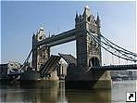
Typical features of British character
British are usually considered to be unemotional, independent, reserved and a little bit eccentric. Besides they possess a specific sense of humour based on play on words, irony and subtle meanings of words.

Slide 7
Britain is supposed to be the land of law and order.
The British people are prudent and careful about almost everything. Their lawns are closely cropped, their flower beds primly cultivated, and their trees neatly pruned. Everything is orderly. Drinks are carefully measured, seats in a cinema are carefully assigned.

Slide 8
They have a special attitude to their homes.
They often talk about the weather.
Tea is a national passion.
They love animals.
British are the law-abiding people.
The British are famous for their humor.
They love gardening.
The British raise their children in severity
They do not tolerate excessive displays of emotion.

Slide 9
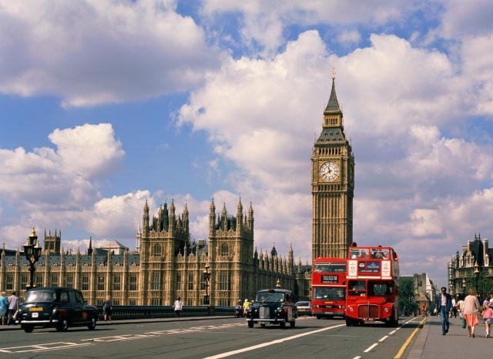
These characteristics have been noted by people from all over the world.
Travel agencies give tourists, who are going to visit Great Britain some useful tips. It’s very important for tourists to avoid embarrassing situations.

Slide 10
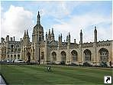
Useful tips for travelers
Punctuality is always welcome in England. It is best to come to a meeting for a few minutes before
The British make decisions slower than, say, the Americans. For this reason, they should not be rushed
Standard greeting is a handshake for a business meeting and visiting

Slide 11
Manners are important in communication. There are some DOs and DON'TS (Taboos) in England.
Privacy is very important for the British. So don’t ask personal questions and show attention to the other person
During the communication the British rarely support eye contact
Don’t ask your interlocutor about what he doesn’t want to talk

Slide 12
The British take their personal space in a special way, so you need to keep the distance in a communication. Considered inappropriate to touch the interlocutor
It’s better not to talk about the work after a long day
Don’t talk too loud and behave inappropriately

Slide 13
Check yourself
Would it be OK to start a conversation with a stranger?
+
Would you share a bench in the park with a stranger?
--
Is it OK to be late for a party?
+
When you are in the cinema will you take an empty seat or a seat reserved for you?
The second

Slide 14
Check yourself
Is it impolite if your British friend always keeps distance?
--
How would you greet grown-ups/ your British friend in Great Britain?
Hello/Hi
Would you take offense if the British refused working with you?
--

Slide 15
What questions would you ask the Englishman?
-How much do you earn?
-How much do you weigh?
-Why aren't you married?
-Do you believe in God?
- How much is your car?
- How old are?(an elderly woman)
All these questions are impolite

Slide 16
Bibliography
Cambridge Advanced Learners Dictionary
http://resources.woodlands-junior.kent.sch.uk/customs/behaviour.html
http://b-bright.ru/ob-anglii/portret_anglichanina/
http://london-life.ru/nravy-tradicii-privychki-i-obraz-zhizni-anglichan/
http://econf.rae.ru/pdf/2009/10/8cb22bdd0b.pdf
http://expat.su/uk/category/mentalitet/
http://lingua-source.com/2011/08/12/national-identity-and-mentality-of-the-british/

