Slide 1
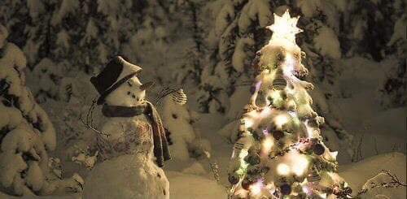
МОУ «Лицей №4 г. Дмитрова»
Исследовательская работа по английскому языку
New Year in Russia and Christmas in England
Работу подготовила: ученица 7Г класса ФЕДОРЕНКО Юлия Руководитель: Наталья Владимировна КОНДАКОВА
Дмитров 2023 г.

Slide 2
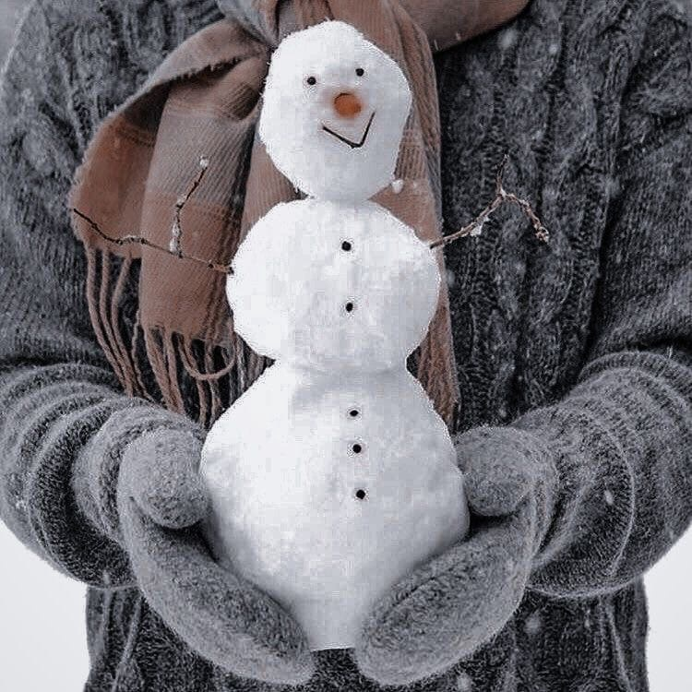
Relevance and problem of the project:
Many students at my school, when visiting an another country, may don’t know its traditions and customs, which may cause misunderstandings when communicating with foreigners. Also, more information about the manners of other countries will help develop the horizons of other people. Therefore, I believe that the theme I have chosen is relevant.
Hypothesis:
If I manage to notify my peers and inform them about the traditions of families in England, this will prevent most of the awkwardness or misunderstandings that they may have while living in England.
Investigation object:
National holidays in Russia and in England: New Year and Christmas.
Practical significance:
The results of my practical work can be useful for the study of different traditions among peoples in order to inform the population and raise awareness among people.

Slide 3
The purpose of the work:
To present to people the similarities and differences of the holidays of Christmas and New Year. Also, in general, tell about Christmas.
Tasks:
collect information about the origin of the holidays (compare)
learn about the characters; symbolic dishes; attributes and traditions associated with the holidays
conduct a survey about holidays among classmates
make conclusions

Slide 4
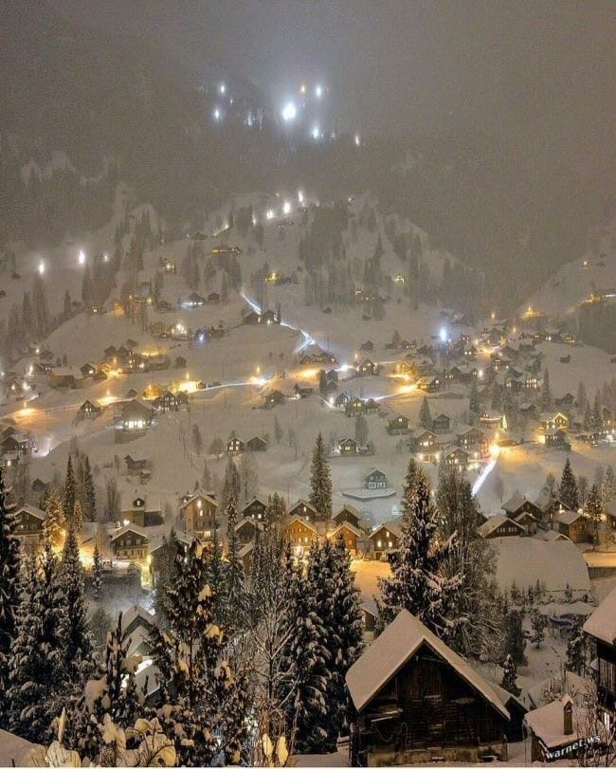
• Why did I choose this theme?
I am very interested in the English language, England itself and its traditions; holidays. Also, one of my favorite holidays is the new year and I was wondering how Christmas differs from it.

Slide 5
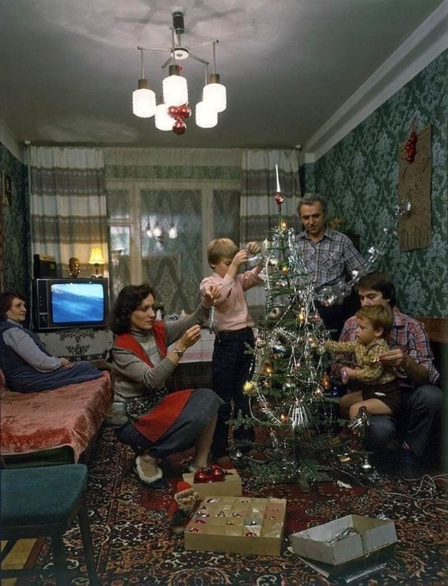
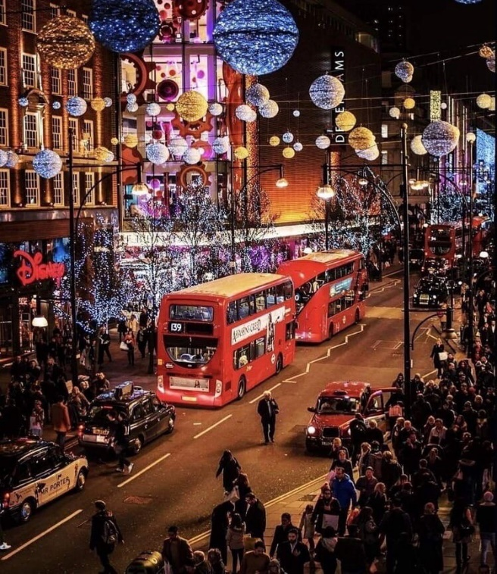
Basic information
New Year is the most favorite holiday of most adults and children, because on the night of December 31 to January 1, the most real wonders happen. It is accepted that the new year begins on January 1 according to the Gregorian calendar.
Christmas is a Christian holiday dedicated to the birth of Jesus Christ. Officially, Christmas in the USA is celebrated on December 25, but usually Americans celebrate it for several days. The tradition of long week-long vacations in the world has been born since the Stone Age. With the advent of a new chronology associated with the baptism of Rus, the date of March 1 was fixed for the holiday, later it moved to September 1. In 1699, king Peter I issued a decree on the celebration of the New Year on January 1. This was done following the example of everyone.

Slide 6
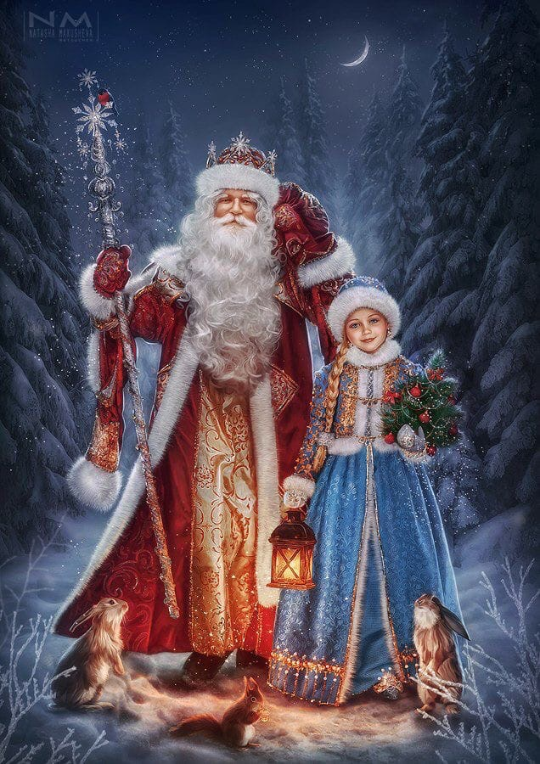
Characters
Russia
Father Christmas
An old man with a long gray beard, arriving on three horses late at night, when everyone is already asleep, quietly enters the houses and leaves gifts under the Christmas tree. It appeared in the days of paganism. With the adoption of Christianity, Morozko began to be presented as a negative hero, and only in Soviet times the image of a kind grandfather returned. For many years, children have had a tradition of writing letters to Santa Claus, who lives with his granddaughter Snow Maiden.
Snow Maiden
The granddaughter of Father Christmas. There are several versions about its origin. Some believe that the Snow Maiden is the embodiment of the goddess of winter Morana, others - that she is the prototype of the stuffed Kostroma, and others – that the Snow Maiden came from the goddess of spring Lelei.

Slide 7
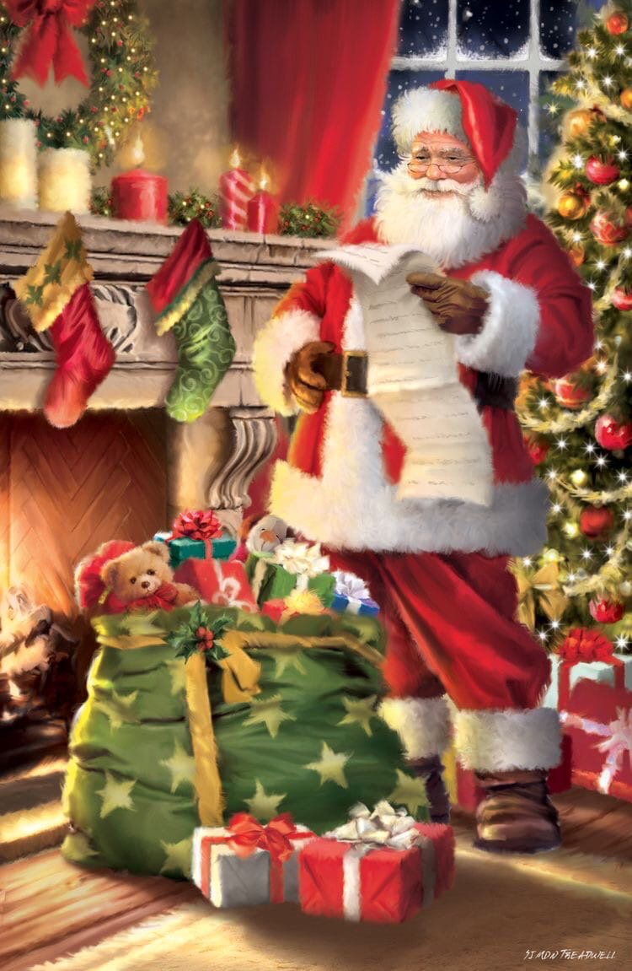
Characters
England
Santa Claus
Who is also called Santa, Father Christmas in the UK– is a grandfather in red clothes with a long white beard. They say Santa lives at the North Pole. In Finland, they say that he lives in the northern part of the country, in Lapland. But everyone is united in one thing – he travels across the sky on a sled in a reindeer team, gets into the house through the chimney at night and puts gifts for children in stockings over the fireplace and in front of the Christmas tree.

Slide 8
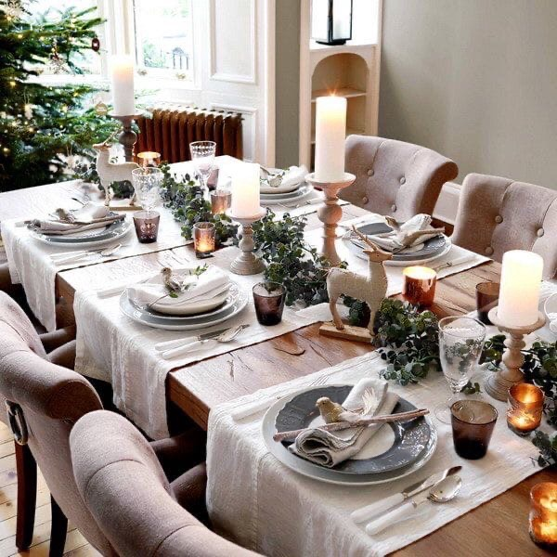
What is customary to do for the New Year?
Gather the whole family. Most people want to celebrate the holiday in a warm, cozy, homely atmosphere. To raise glasses of foaming champagne, to make a wish with family and friends, to sit at a festive table.
Usually, dishes such as:
• Salad "Olivier"; salad "Herring under a fur coat"
• Red caviar
• Jelly
• Tangerines
• Cake "Napoleon"; cake "Prague"
• Alcoholic beverages; juice

Slide 9
Decorations
Decorate the house. It has been customary to create a festive atmosphere in the house since ancient times.
Tinsel is hung on the walls and the Christmas tree, windows are decorated with garlands, candles, glass balls, vases with nuts and fruits are placed all over the house. Some hang holiday angels, other holiday heroes. People also light sparklers.
To give gifts. It was the same before, people congratulated each other on the end of the old year and the beginning of something absolutely beautiful.
Decorate the Christmas tree. The whole family decorates the Christmas tree with bright New Year's toys and the children are waiting for Santa Claus to leave gifts under it (this happens on New Year's Eve).
Start fireworks. After the onset of January 1, people go outside and launch a lot of purchased firecrackers and fireworks.

Slide 10
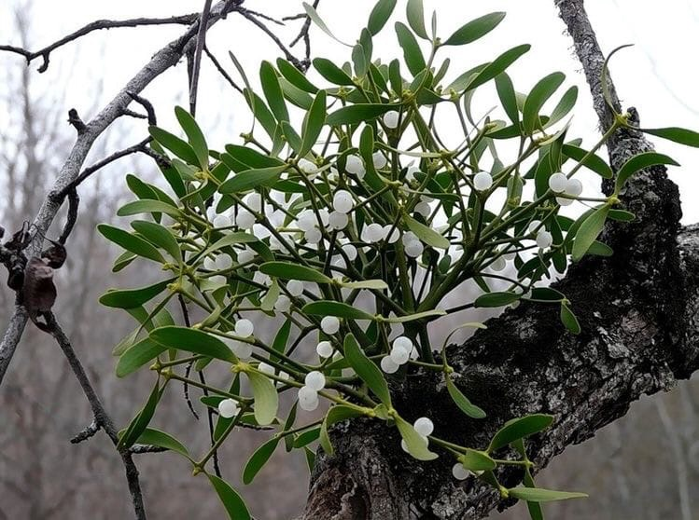
What is customary to do at Christmas?
Christmas stockings. On Christmas night, it is customary to hang socks over the fireplace or bed, hoping that something will fall there.
Greenery for decorations. Symbolic plahouse. For example:
• Holly was used before Christmas as nts with their own meaning are used as decorations for the decorations during the winter solstice festival.
• Ivy. He has to cling to something to find support and grow.
• Mistletoe. It has mystical properties that bring good luck to the house and expel evil spirits. Before each kiss, a berry was torn from the mistletoe, and this continued until there were no berries left on the twig at all.

Slide 11
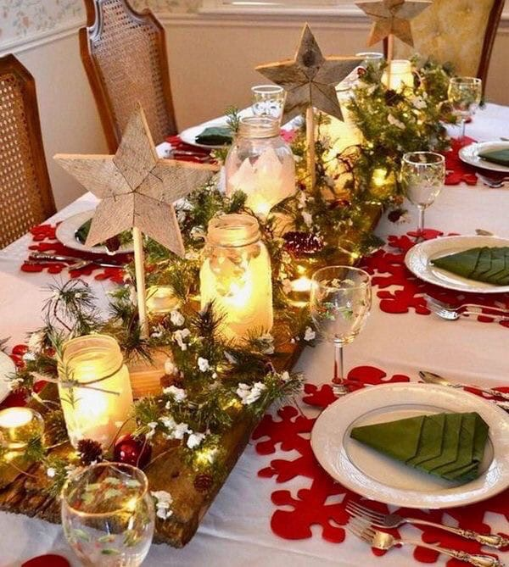
Decorations
England
Christmas songs. They were first performed in Europe thousands of years ago. But these were pagan songs that were sung around stone circles during the celebration of the winter solstice. Christmas songs are special songs that are performed on Christmas Day. They sing about Jesus Christ and the time of his birth.
Family dinner. The whole family gathers and tastes Christmas dishes, opening gifts and celebrating the holiday together.
Usually, dishes such as:
• Fried poultry
• Chocolate pudding
• Christmas cookies
• Meat in cranberry syrup
• Punch
• Baked apples

Slide 12
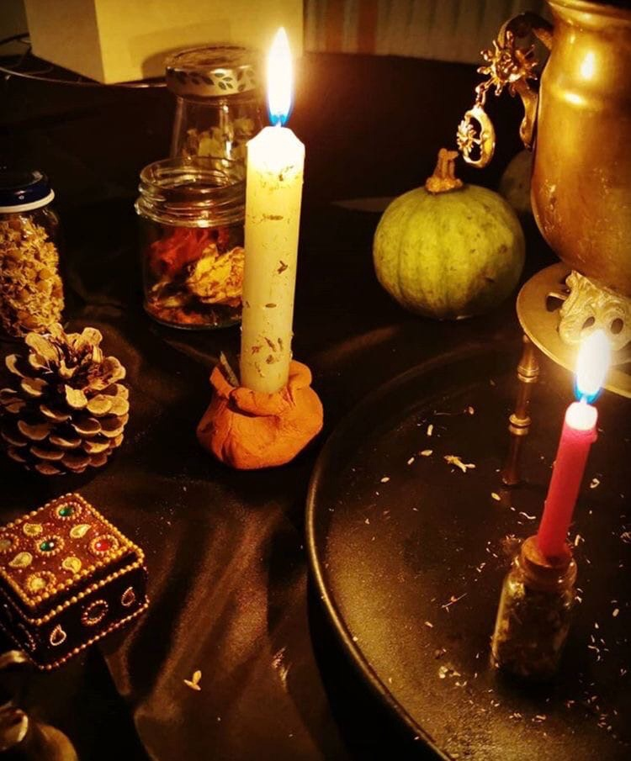
Decorations
England
Christingle. Its name means "the light of Christ" who came into this world. A candle is placed in the center of the orange, and the directions of the four sticks indicate the directions to the north, south, west and east. Fruits, sweets and nuts symbolize the gifts of Mother Earth.
Yule log. In England, it was prepared a year before Christmas. A huge tree was selected in the forest, it was cut down and left lying. On the Christmas holiday, a log from this tree was brought into the house only by the head of the family. The log was watered with honey, wine, and sprinkled with grain. Then the log was placed in the hearth and set on fire, it should burn for 12 days and nights.
Caramel cane. One of the sweet symbols of Christmas is, of course, a caramel cane. Caramel in the shape of a cane. Traditionally, it is white with red stripes with a taste of cinnamon and mint.
Family dinner. The whole family gathers and tastes Christmas dishes, opening gifts and celebrating the holiday together.

Slide 13
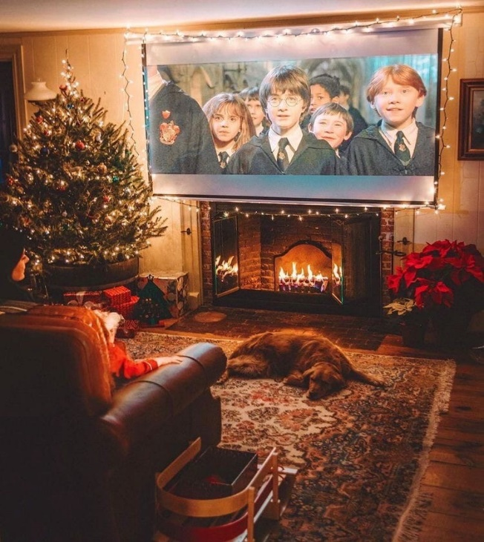
Conclusion
We managed to learn the stories and traditions of the New Year and Christmas holidays. We also managed to compare them, find similarities and differences.
Differences:
• The main characters of the holidays have different names.
• Decorations vary.
• Different dishes on festive tables.
• Christmas, first of all, is a Christmas holiday, and the New Year is a secular one, which is celebrated in honor of the change of the calendar date.
Similarities:
• Holidays are celebrated in winter.
• Each main character is a big grandfather in a red uniform and with a white beard.
• In honor of the holidays, people decorate a Christmas tree; prepare a festive table.
• In honor of the holidays, people give each other gifts.

Slide 14
Result.
The results of my practical work can be useful for the study of different traditions among peoples in order to inform the population and raise awareness among people.
I really enjoyed working on the research, I learned a lot about Christmas in England and now I have something to tell my friends or my family about.

Slide 15
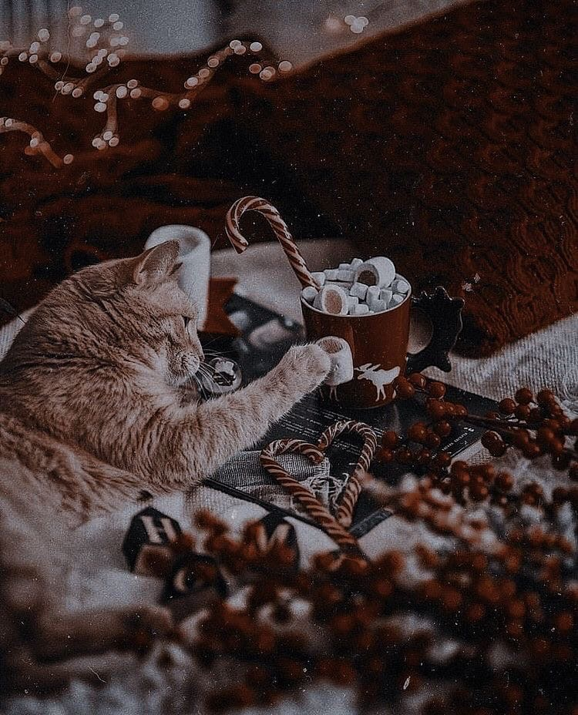
Thanks for your attention!

