Slide 1

Презентация к уроку
по английскому языку
в 3 классе
«Любимые сказка»
Учитель Нудная Ю.В.
МАОУ СОШ 111

Slide 2
1) She is a beautiful girl. She is slim. She has got dark hair and lovely eyes. She is very kind and she has got a lot of friends.
2) She is pretty. She has got fair hair and beautiful mouth. She is slim. She is kind and she is not lazy.
3) He is very funny and brave. He has got a long nose and big eyes. He is wooden.
4) He is very funny but he is not very clever. He is fat. He is kind and he has got a lot of friends.
5) She is very angry and strong. She is tall and slim.

Slide 3
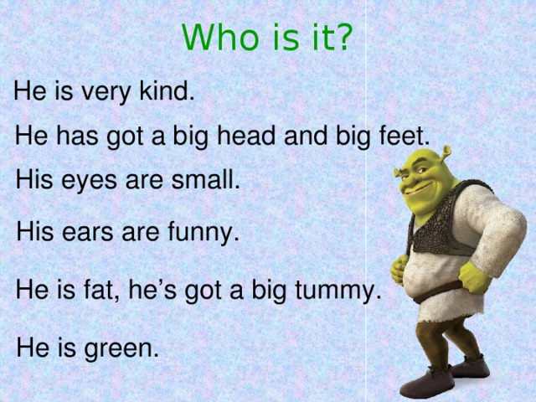

Slide 4
Who is it?
She is a beautiful girl.
She is slim.
She has got dark hair and lovely eyes.
She is very kind and she has got a lot of friends.

Slide 5
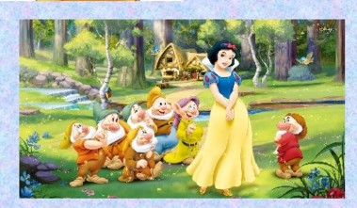
Snow White

Slide 6
Who is it?
She is pretty.
She has got fair hair and beautiful mouth.
She is slim.
She is kind and she is not lazy.

Slide 7
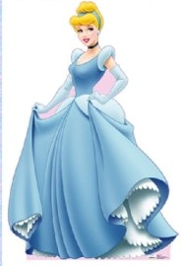
Cinderella

Slide 8
Who is it?
He is very funny and brave.
He has got a long nose and big eyes.
He is wooden.

Slide 9
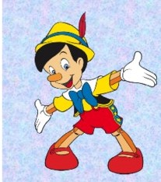
Pinocchio

Slide 10
Who is it?
She is very angry and strong.
She is tall and slim.

Slide 11
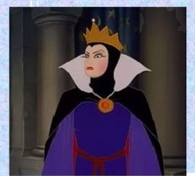
The wicked stepmother

Slide 12
Who is it?
He is very funny but he is not very clever.
He is fat.
He is kind and he has got a lot of friends.

Slide 13
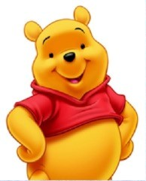
Winnie the pooh

Slide 14
New words
Big - small большой – маленький
Kind - angry добрый - злой
Rich - poor богатый - бедный
Happy - sad веселый - грустный
Old - new старый - новый
Fat - slim толстый - худой
Ugly – nice, pretty, уродливый- милый, хорошенький,
beautiful, lovely красивый, прекрасный
Long - short длинный – короткий
Clean - dirty чистый - грязный

Slide 15
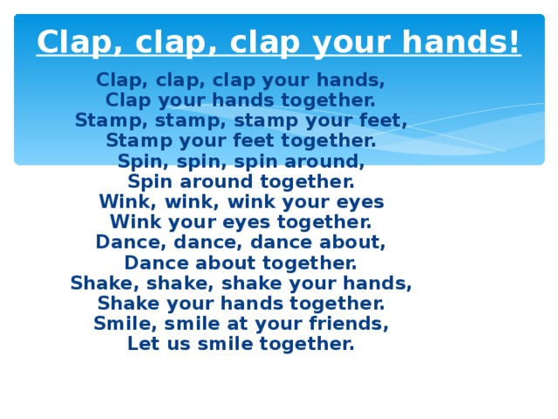
Физкультминутка
https://yandex.ru/video/preview/1686228676532803106?init_meta=bg-bert-video&wizextra=video_bg_bert_query_model%3DbegemotFullSplit%3Aprod

Slide 16
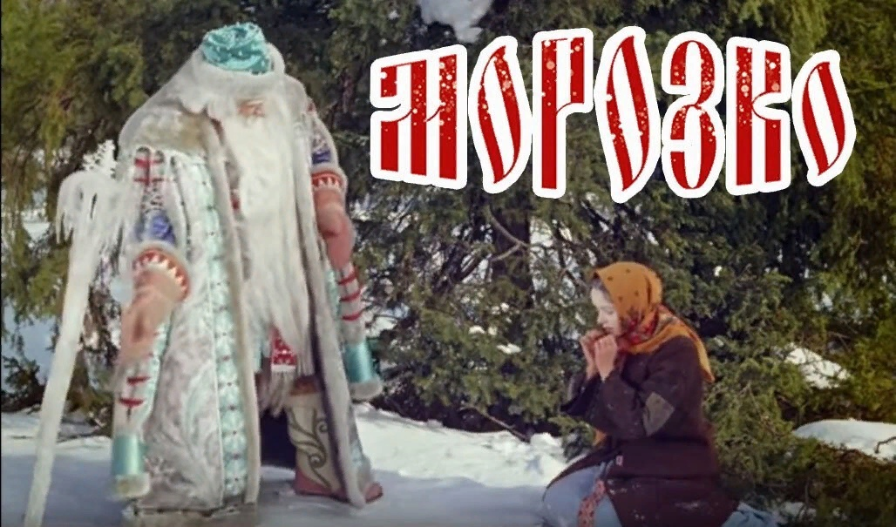

Slide 17


Slide 18
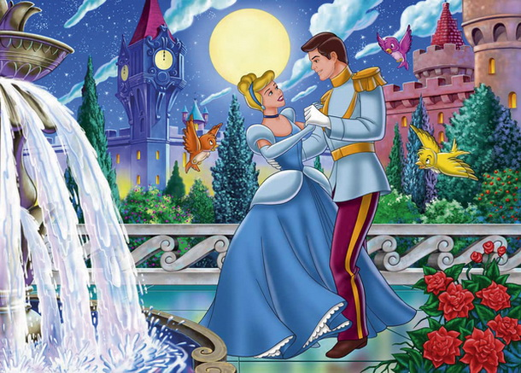

Slide 20
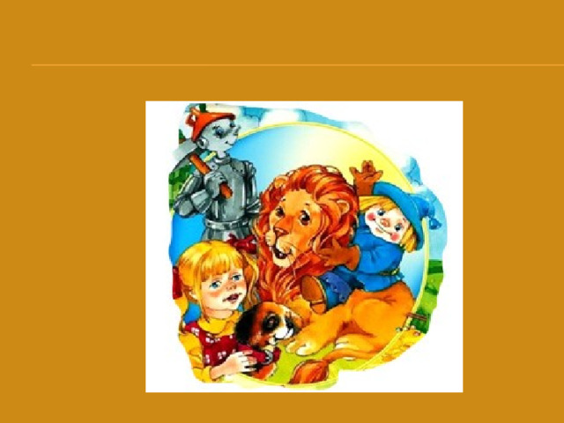
HOME WORK
ДОМА НАИСУЙТЕ ЛЮБИМОГО СКАЗАЧНОГО ГЕРОЯ И ПОДГОТОВЬТЕ ОПИСАНИЕ ЕГО ВНЕШНОСТИ И ХАРАКТЕРА

Slide 21
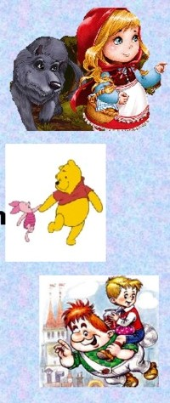
That’s all for today.
Do you like our lesson?
Our lesson is over. Thank you for your work.
Goodbye!

