Slide 1
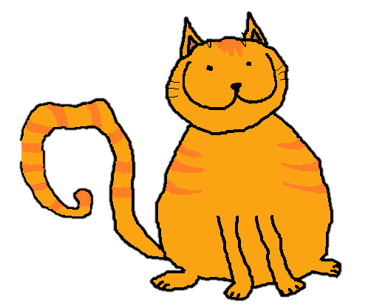
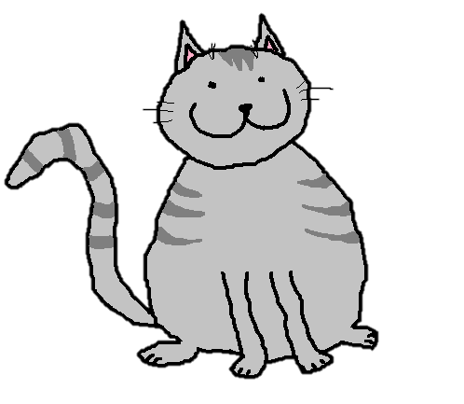
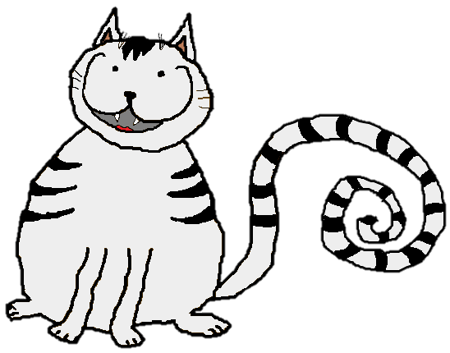
Murzik
Vasia
longer
long
Tisha
the longest

Slide 2
1.
One-syllable (short) adjectives
the…+ est
long
longer
the longest
fast
faster
the fastest
slow
slower
the slowest
Tisha’s tail is the longest.

Slide 3
Murzik
Vasia
longer
long
Tisha
fatter
fat
the longest
the fattest

Slide 4
2.
VERY short adjectives
the + est
fat
fatter
the fattest
hot
hotter
the hottest
big
bigger
the biggest
Tisha is the fattest.

Slide 5
Murzik
Vasia
happier
happy
longer
long
Tisha
the happiest
fatter
fat
the longest
the fattest

Slide 6
3.
One-syllable (short) adjectives - y
the… Y= i + est
happy
happier
the happiest
pretty
prettier
the prettiest
funny
funnier
the funniest
Tisha is the happiest.

Slide 7
Murzik
Vasia
happier
happy
longer
long
Tisha
the happiest
fatter
fat
the longest
beautiful
more beautiful
the fattest
the most beautiful

Slide 8
4.
Two (three\four) -syllable (long) adjectives
the most+
beautiful
more beautiful
the most beautiful
expensive
more expensive
the most expensive
exciting
more exciting
the most exciting
Tisha is the most beautiful.

Slide 9
5.
Irregular adjectives
good
better
the best
bad
worse
the worst
far
further
the furthest
Tisha is the best.

Slide 10
What was the example?

Slide 11
1.
One-syllable (short) adjectives
the…+ est
long
longer
the longest
fast
faster
the fastest
slow
slower
the slowest
Tisha’s tail is the longest.

Slide 12
2.
VERY short adjectives
the + est
fat
fatter
the fattest
hot
hotter
the hottest
big
bigger
the biggest
Tisha is the fattest.

Slide 13
3.
One-syllable (short) adjectives - y
the… Y= i + est
happy
happier
the happiest
pretty
prettier
the prettiest
funny
funnier
the funniest
Tisha is the happiest.

Slide 14
4.
Two (three\four) -syllable (long) adjectives
the most+
beautiful
more beautiful
the most beautiful
expensive
more expensive
the most expensive
exciting
more exciting
the most exciting
Tisha is the most beautiful.

Slide 15
5.
Irregular adjectives
good
better
the best
bad
worse
the worst
far
further
the furthest
Tisha is the best.

